Slide 1



Connecting the Dots: IoT and IIoT - A Comparative Perspective

Slide 2
(1) Introduction of Topic
PURPOSE
IoT: Consumer-focused
IIoT: Industrial-focused
MOTIVATION FOR STUDY
IoT: Personal interest, innovation, career opportunities, market growth
IIoT: Industrial impact, problem-solving, job opportunities, security, sustainability.
BACKGROUND OF STUDY
Both IoT and IIoT have their roots in the idea of connecting objects to the internet, but they have distinct focuses and applications.
IoT is more consumer-oriented, while IIoT is geared toward optimizing industrial operations.

Slide 3

(2) Introduction of the Topic
METHODOLOGY
It outlines the research approach and techniques used to explore the fundamental concepts, applications, and key differences between IoT and IIoT.
SCOPE
To explore the fundamental concepts, applications, and key differences between IoT and IIoT.
LIMITATIONS
It may not cover all possible applications and use cases of IoT and IIoT.
SCHEME OF CHAPTERIZATION
It discusses purpose of comparative analysis, Key Concepts, Technological Differences, Industrial Applications, Case Studies and Future Trends.

Slide 4
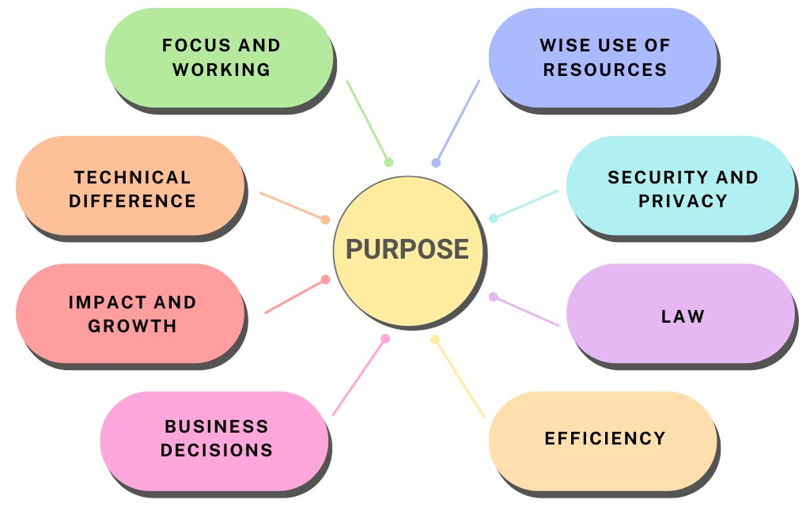
(3) Purpose of Comparitive Analysis of IoT and IIoT

Slide 5
(4) Key Components and Applications of IoT
Key Components of IoT
Applications of IoT
Devices and Sensors
Connectivity and Scalability
Data Processing and Analysis
User Interface and Security
Interoperability and Standards
Smart Home and City
Healthcare
Agriculture
Logistics and Supply Chain
Environmental Monitoring

Slide 6
(5) Key Components and Applications of IIoT
Key Components of IIoT
Applications of IIoT
Devices and Sensors
Edge Computing
Data Analysis and Learning
Industrial Control Systems
Regulatory Compliance
Manufacturing and Industry
Energy Management
Supply Chain and Logistics
Smart Agriculture
Healthcare and Medical Devices

Slide 7
(6) Technological Differences
Connectivity
Data Volume and Velocity
Security and Privacy

Slide 8
(7) Industrial Applications of IoT
Benefits
Challenges
Data-Driven Insights
Safety and Security
Cost savings
Automation
Remote Control
Privacy Issues
Data Overload
Security Concerns
Complex Ecosystem
Scalability

Slide 9
(8) Industrial Applications of IIoT
Benefits
Challenges
Predictive Maintenance
Quality Control
Increased Efficiency
Cost Savings
Enhanced Safety
Privacy Issues
Support and Maintenance
Security Concerns
Data Overload
Initial Costs

Slide 10
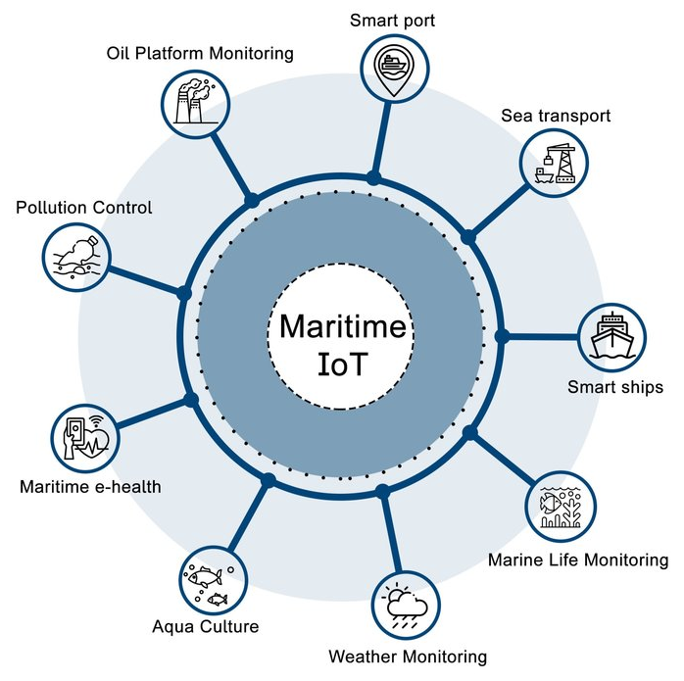
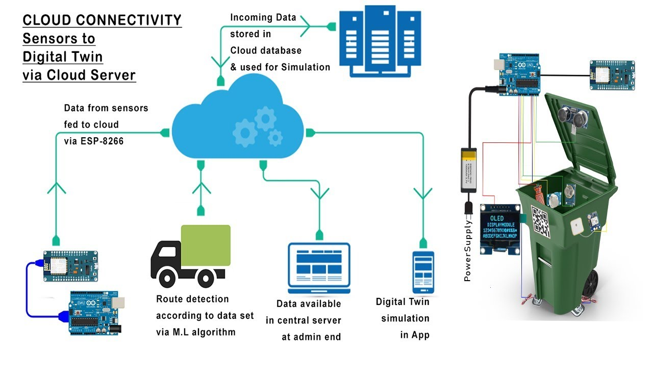
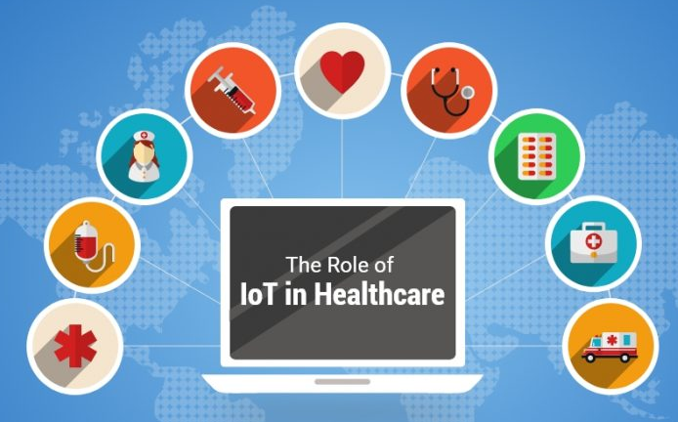
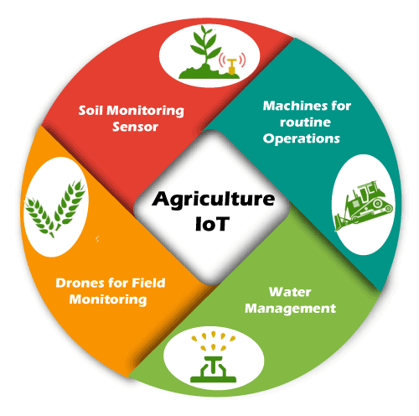
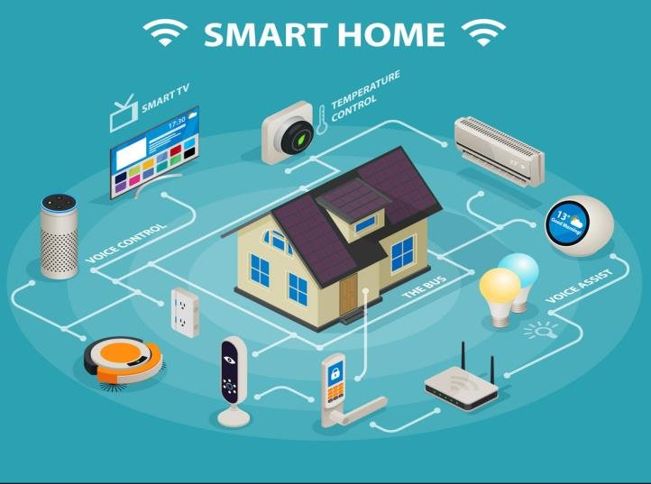
(9) Case Studies of IoT
Waste Management
Healthcare
Marine and Shipping
Smart Home
Agriculture

Slide 11
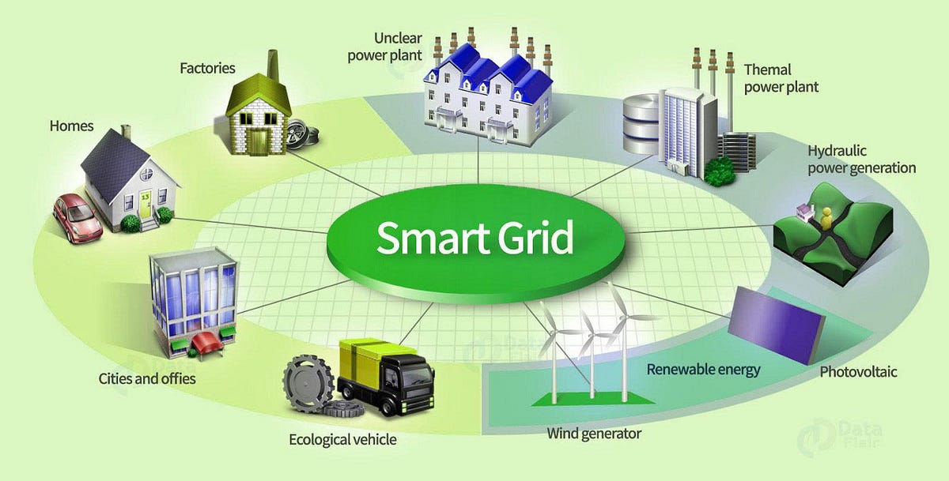
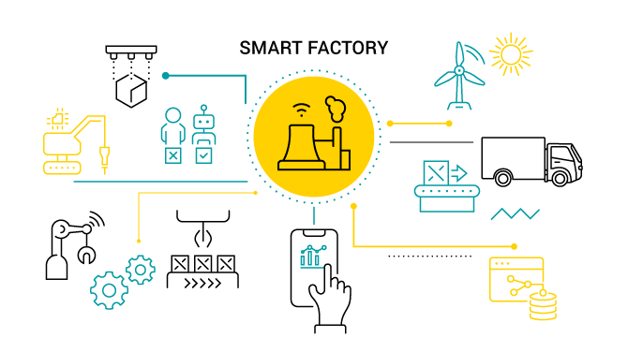
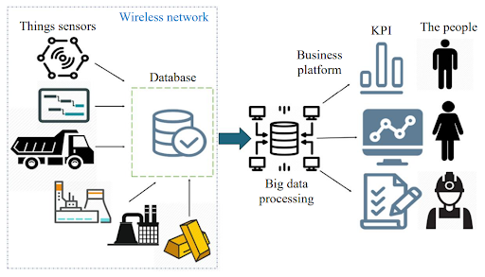
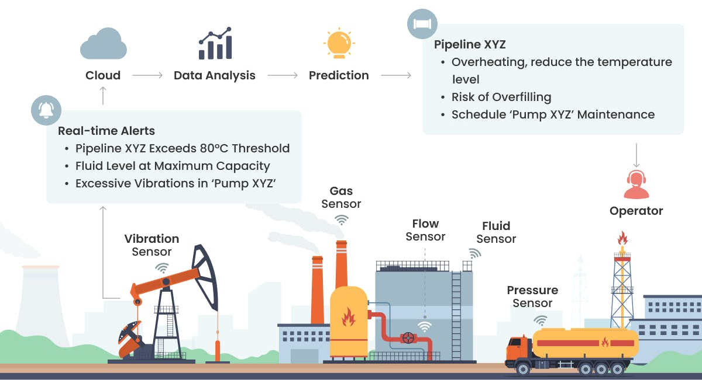
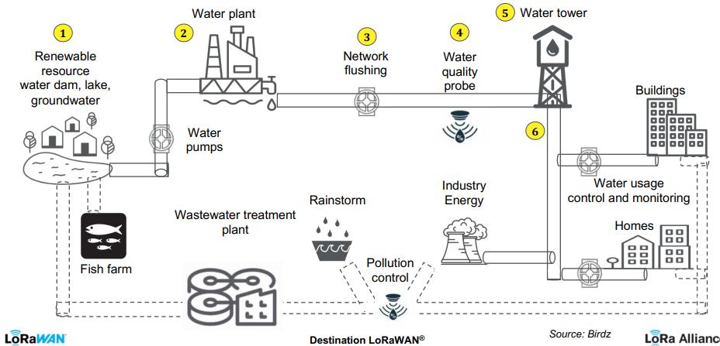
(10) Case Studies of IIoT
Smart Factory
Mining
Smart Grid
Water Management
Oil and Gas Industry

Slide 12

(11) Future Trends
Computing at
the Edge
Smarter IoT
with AI
Super-Fast 5G
Smart Cities
Greener Gadgets
Health Revolution
Farm Tech

Slide 13
(12) Findings
IoT and IIoT share similarities but have distinct purposes and technical intricacies that set them apart.
IoT represents the connection of everyday objects to the internet, transforming our homes and personal lives with smart devices that can communicate and automate tasks.
IIoT focuses on enhancing industries, facilitating the creation of smarter factories and businesses by connecting machines, sensors, and devices.
IoT and IIoT have different connectivity technologies, data volume, and velocity requirements.
IoT and IIoT have various applications and use cases across different industries and sectors.
IoT and IIoT present both challenges and opportunities for businesses and organizations.
The future of IoT and IIoT is promising, with new technologies and applications emerging constantly.

Slide 14
(13) Conclusion
IoT serves consumers and commercial users for daily convenience.
IoT applications include smart homes, wearables, and connected appliances.
IIoT is tailored for industrial sectors, focusing on manufacturing, energy, and healthcare.
IIoT modernizes and optimizes industrial processes, enhancing production and safety.
IIoT emphasizes real-time monitoring, predictive maintenance, and automation.
Both IoT and IIoT face similar technological and security challenges.
Key differences: IoT enhances daily life, while IIoT improves industrial operations.
IoT and IIoT together create a connected, efficient, data-driven world with promising possibilities for the future.

Slide 15
(14) Works Cited
Journals
[1] Deshpande, Sujit & Jogdand, Rashmi. (2020). A Survey on Internet of Things (IoT), Industrial IoT (IIoT) and Industry 4.0. International Journal of Computer Applications. 175. 20-27. 10.5120/ijca2020920790.
[2] Sharma, Nikhil. (2020). Evolution of IoT to IIoT: Applications & Challenges. SSRN Electronic Journal.
Technical Letter
[1] “Techletter: IoT vs. IIoT | betterask.erni”, betterask.erni, 2023 [Online]. Available at: https://www.betterask.erni/news-room/techletter-IoT-vs-IIoT/ [Accessed at: 26-July 2023]
Webliography
[1] “IoT vs IIOT | IIoT-world.com”, IIoT- world, 2023 [Online]. Available at: https://www.IIoT-world.com/industrial-IoT/connected-industry/IoT-vs-IIoT/. [Accessed: 26-July-2023]
[2] “IIoT vs IoT: The Bigger Risks of the Industrial Internet of Things | techopedia.com”, techopedia, 2020 [Online]. Available at: https://www.techopedia.com/IIoT-vs-IoT-the bigger-risks-of-the-industrial-internet-of-things/2/34394 [Accessed: 28-July-2023]

Slide 16
Thank You!!
A presentation by:
Name | Roll No
Enkesh Khajuria | 29
Aryan Kokate | 30
Dakshita Kolte | 31
Atharva Lawale | 32

